Slide 1

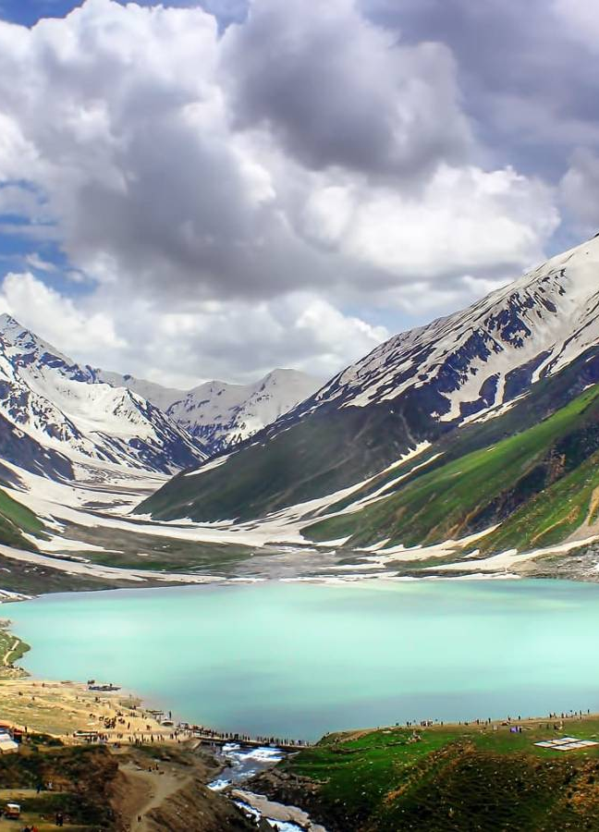
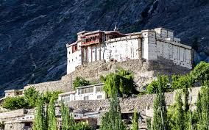
DREAM TRAVEL AGENCY A Travel booking and information Website

Slide 2
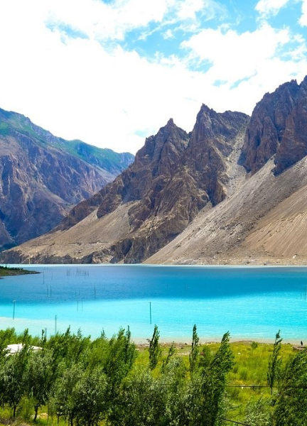
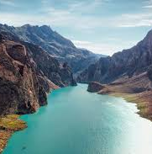
INSTRUCTORS: Mam Ramsha Khalid & Sir Mudassir
GROUP MEMBERS | ROLL NO.
Noor Fatima | 2025-CS-245
Sana Humayun | 2025-CS-257
Zainab Asif | 2025-CS-244
Arisha Mohsin | 2025-CS-290
Meerab Usman | 2025-CS-275

Slide 3
Table of contents
01
02
03
04
05
06
Goals and objectives
About
Services
Contact
Demo Screenshots
Design decisions

Slide 4
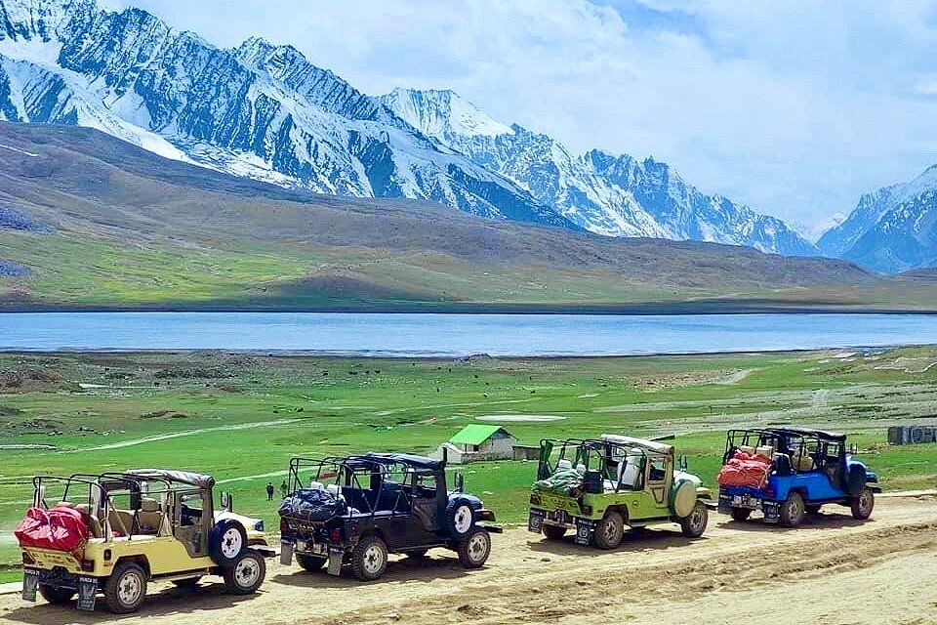

Introduction
Dream Travel Agency is a web-based travel platform designed to help users explore destinations, discover travel services, and easily contact a travel agency. The website focuses on simple navigation, clean design, and user-friendly interaction to provide a smooth and engaging travel planning experience.

Slide 5
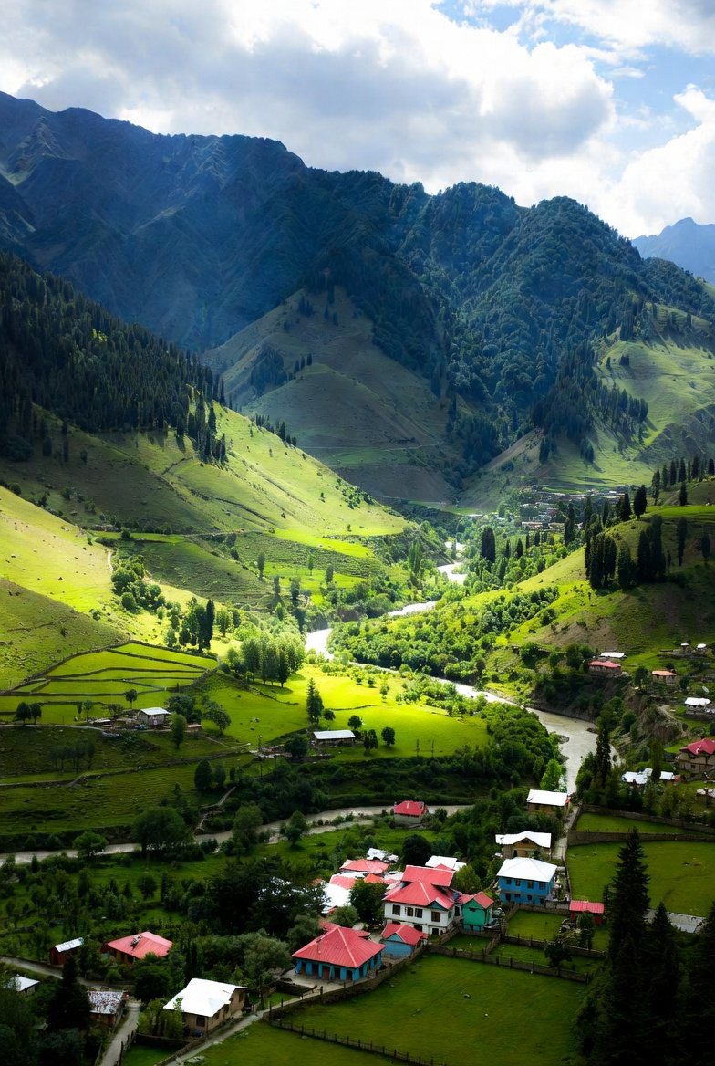

01
Goals and objectives

Slide 6
Travel Planning
Easy Navigation
New Discoveries
Our platform simplifies the complex process of travel planning
We organize information clearly, making it easy to find what you need.
You'll discover new destinations and services you might have otherwise missed
Easy booking
User engagement
Popular destinations
Provide step-by-step guidance to simplify the booking process.
You'll discover new destinations and services you might have otherwise missed
You'll discover new destinations and services you might have otherwise missed

Slide 7
New Inspiration
Travel Support
FAQS
We constantly update our offerings, so you'll always find fresh inspiration.
Our commitment is to empower you with the tools and resources for an extraordinary travel experience
FAQs answer common questions, while the gallery adds visual appeal.
Budget-conscious
User trust
Inspire adventure
Help users plan trips that match their budge.
We constantly update our offerings, so you'll always find fresh inspiration.
We constantly update our offerings, so you'll always find fresh inspiration.

Slide 8
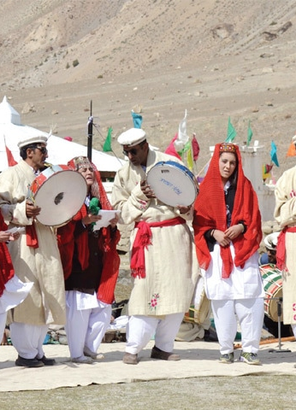

ABOUT
About the agency
Mission and vision
Services offered
Why choose us
Customer-focused approach

Slide 9
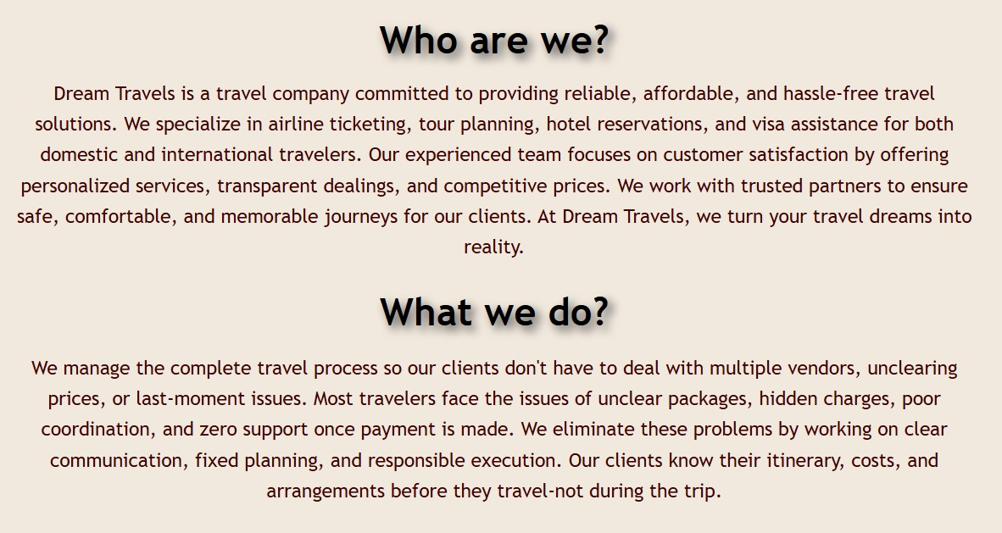

Slide 10
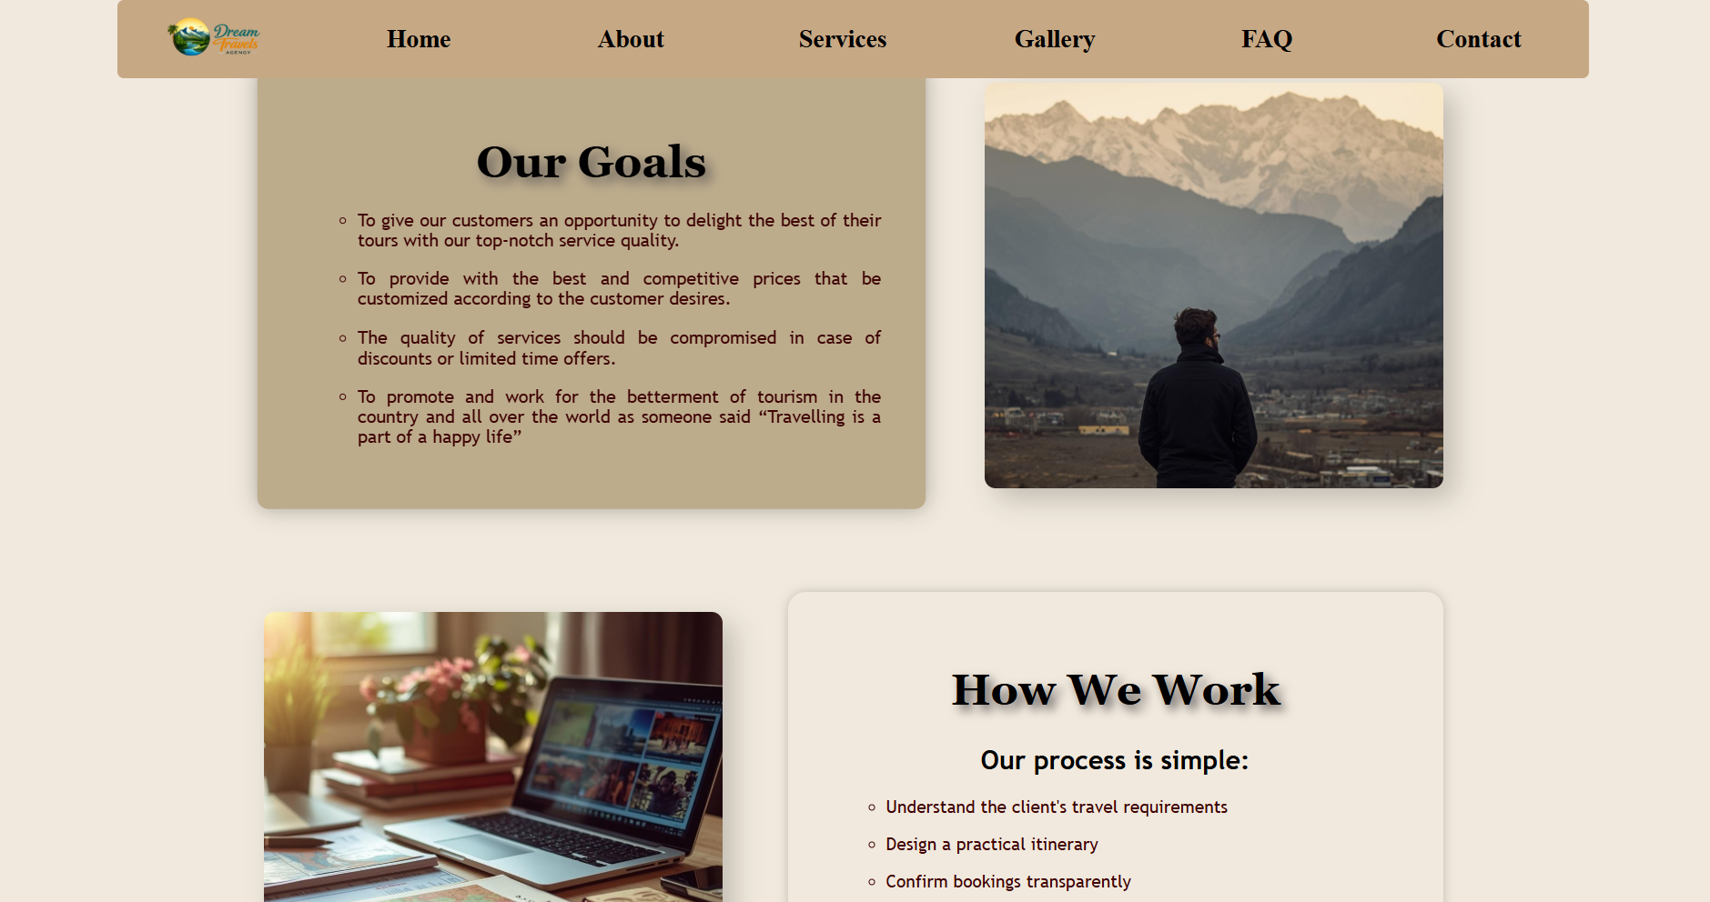

Slide 11
SERVICES
Tour Packages
Flight Booking
Hotel Booking
Travel Guidance
Special Offers

Slide 12
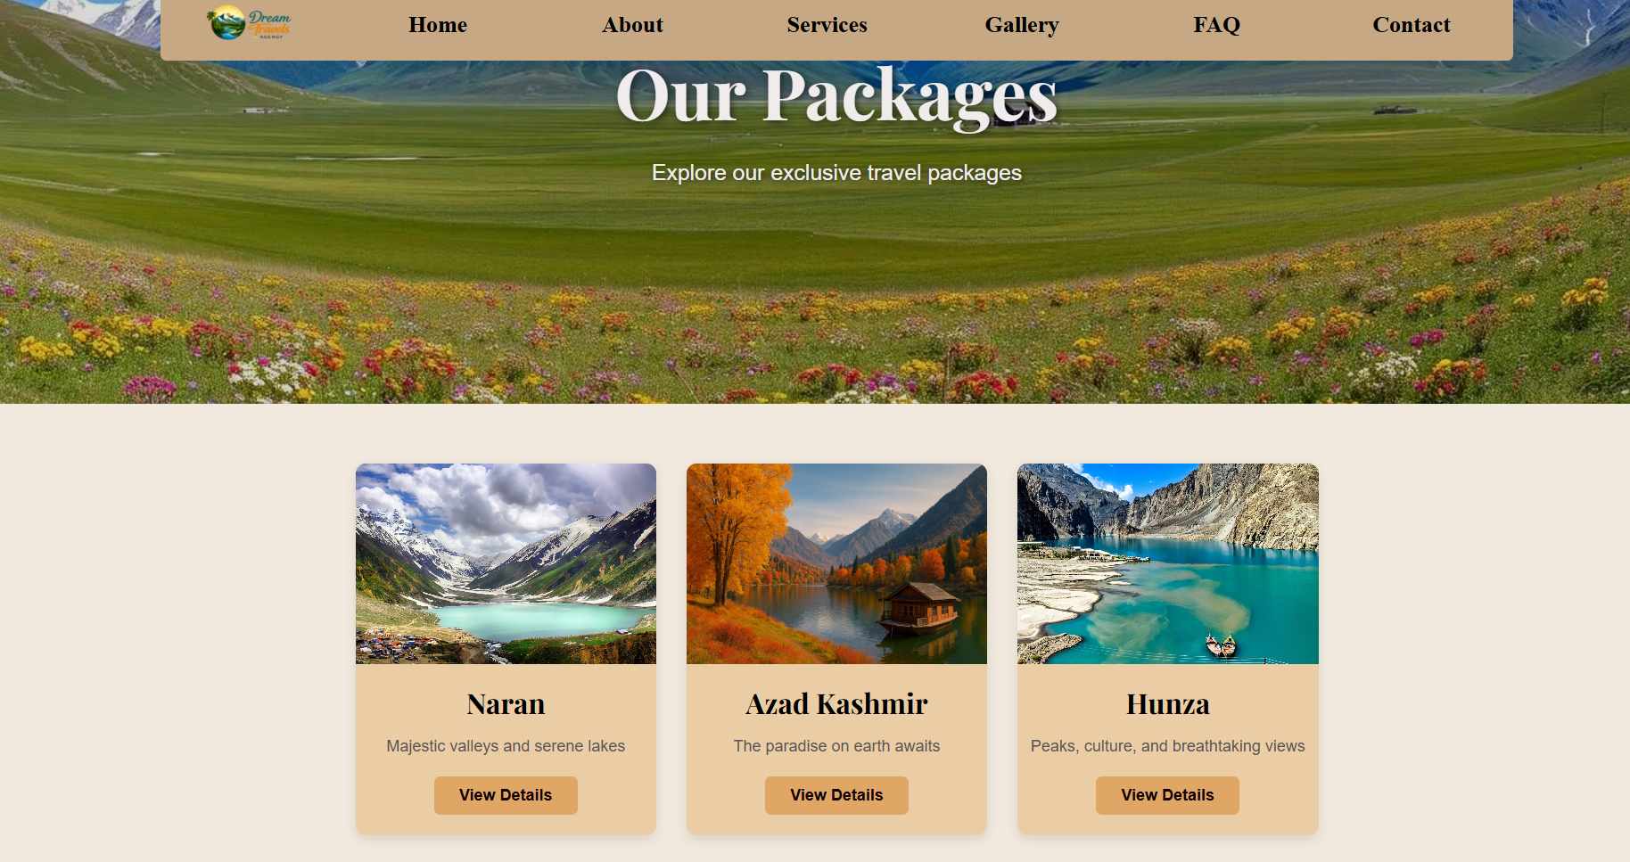
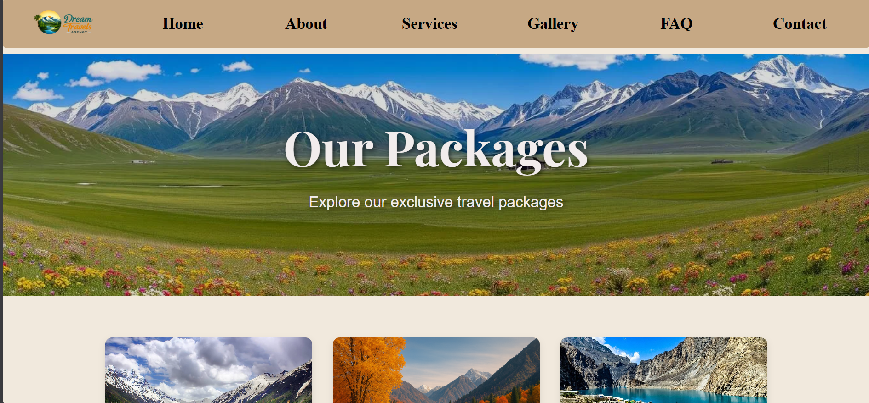

Slide 13
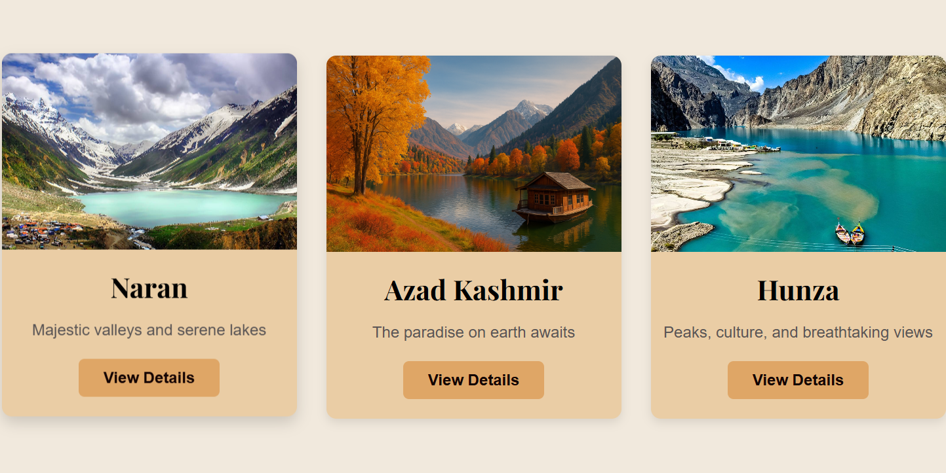
SERVICES

Slide 14
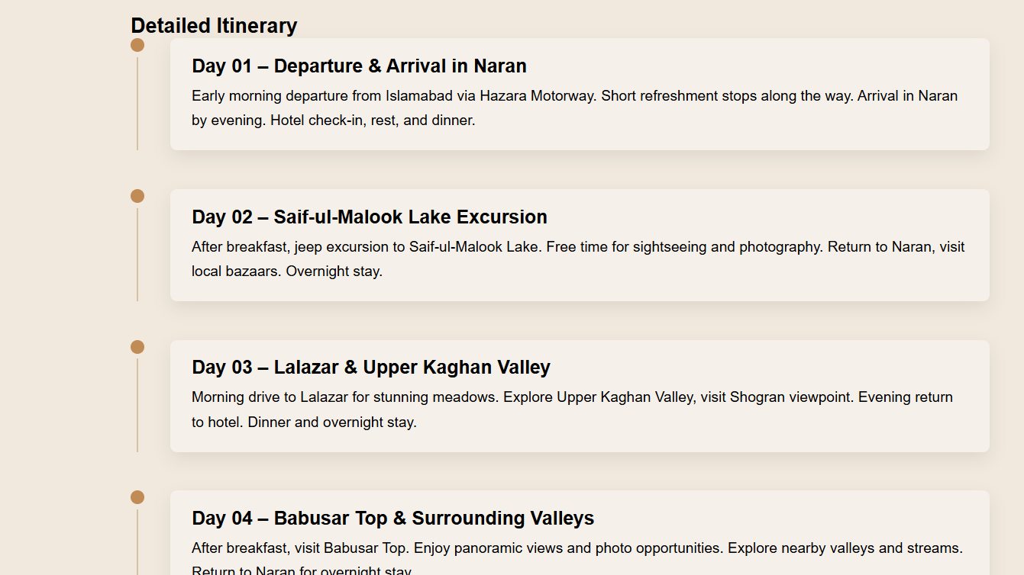
Details of Naran Plan

Slide 15
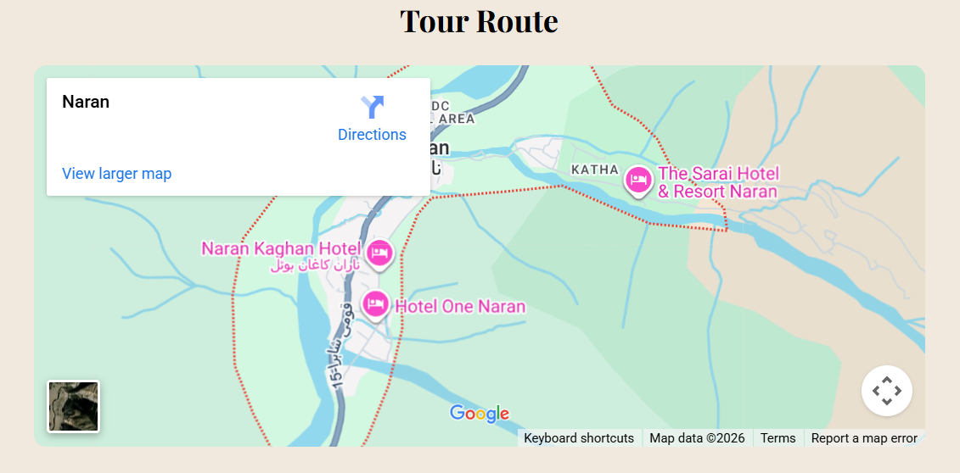

Slide 16
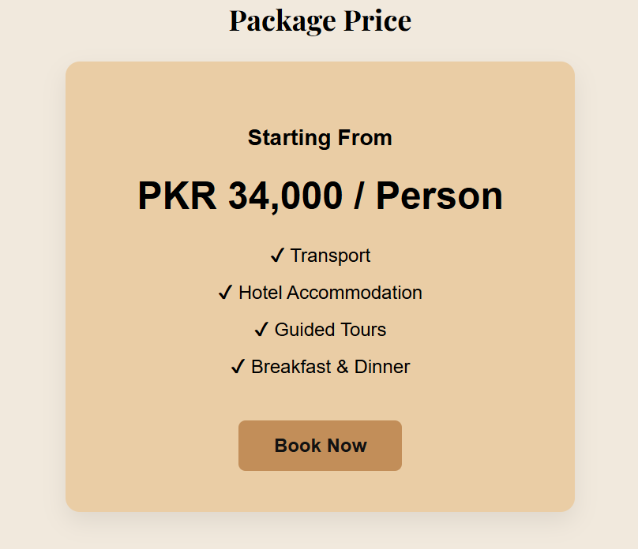

Slide 17

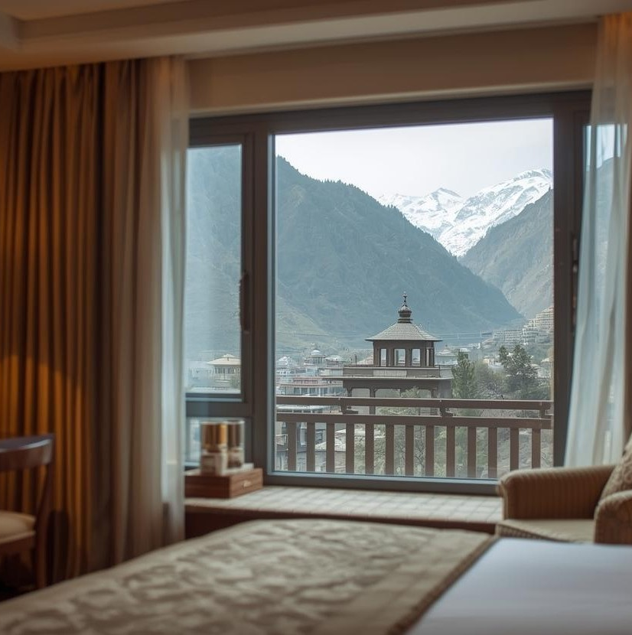
CONTACT
Email & Phone
Budget Inquiry
Hotel Booking
Travel Activity Requests
User Feedback

Slide 18
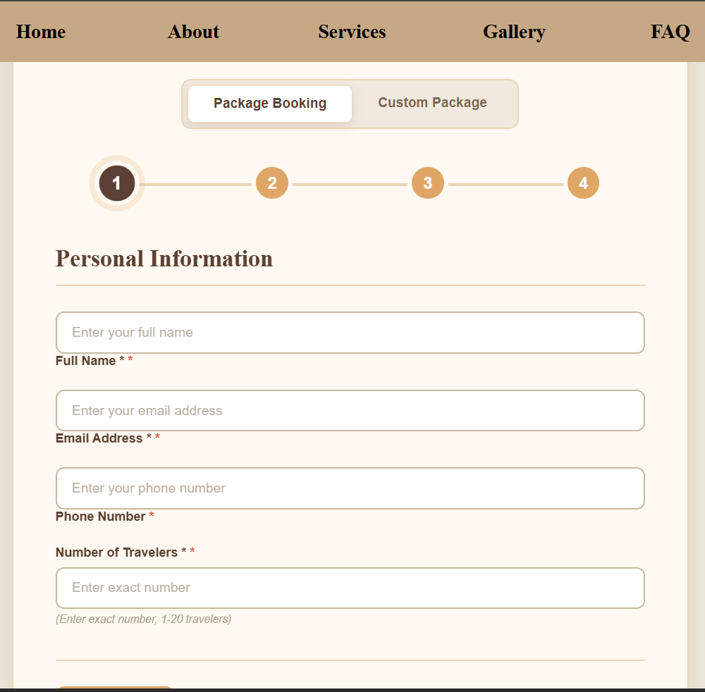

Slide 19
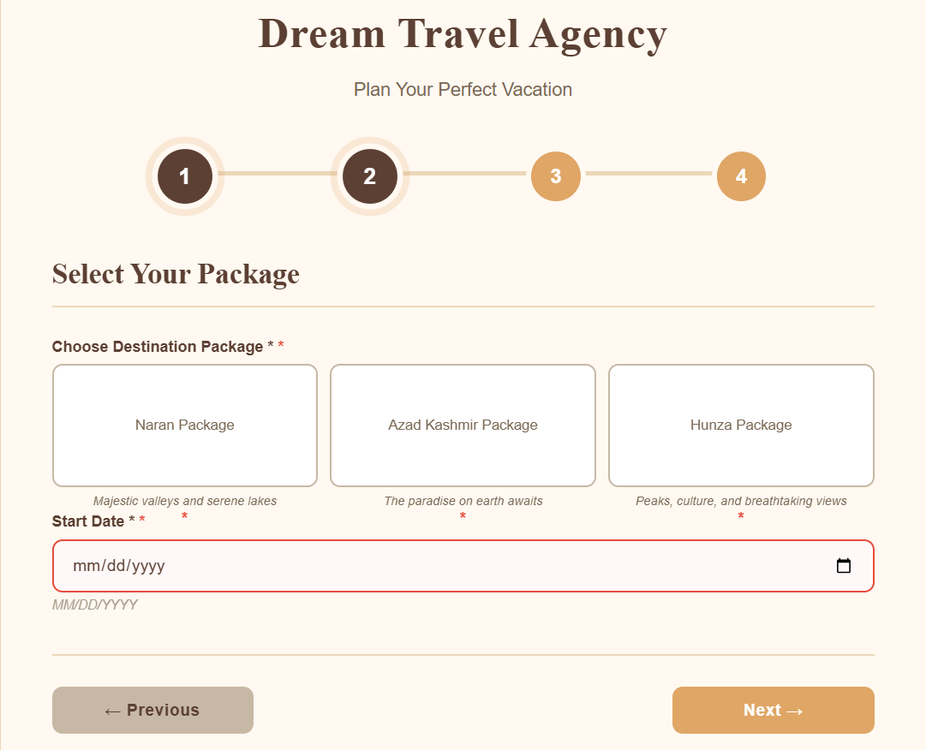

Slide 20
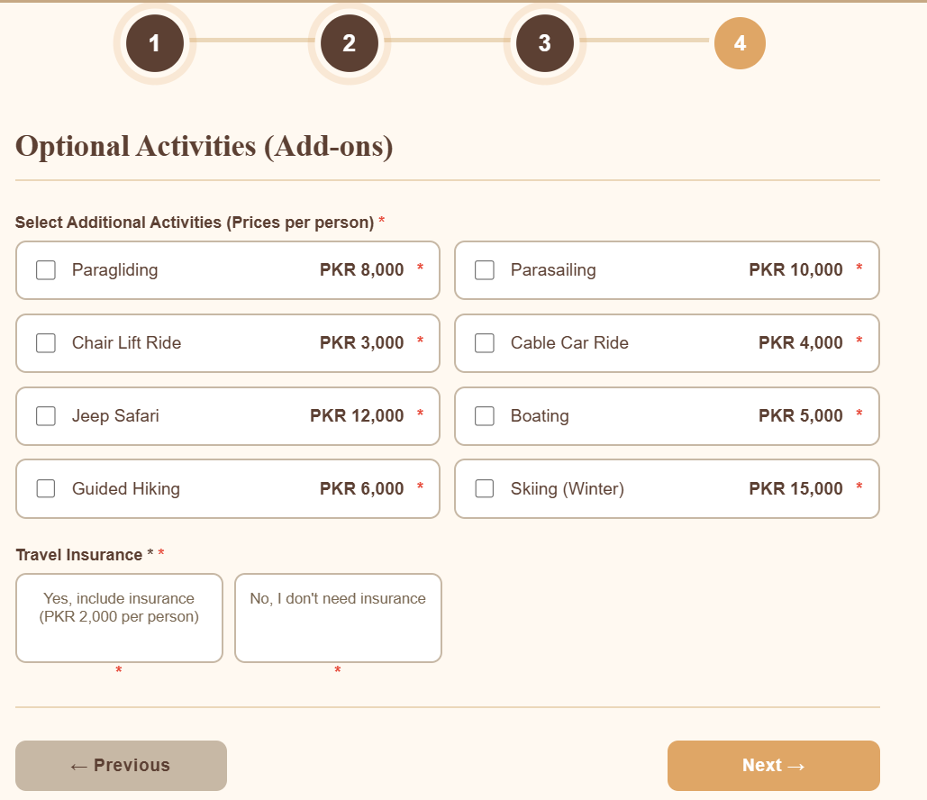

Slide 21
DATA INSIGHT
All data shown in the following slides has been collected and compiled using Microsoft Excel

Slide 22
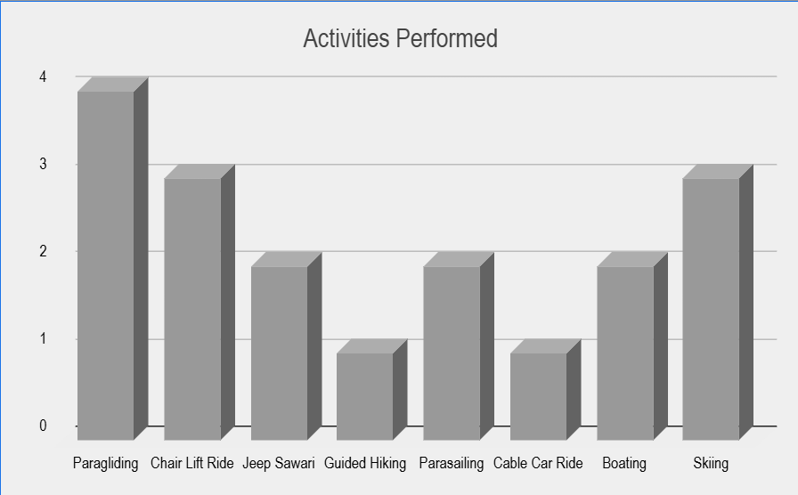

Slide 23
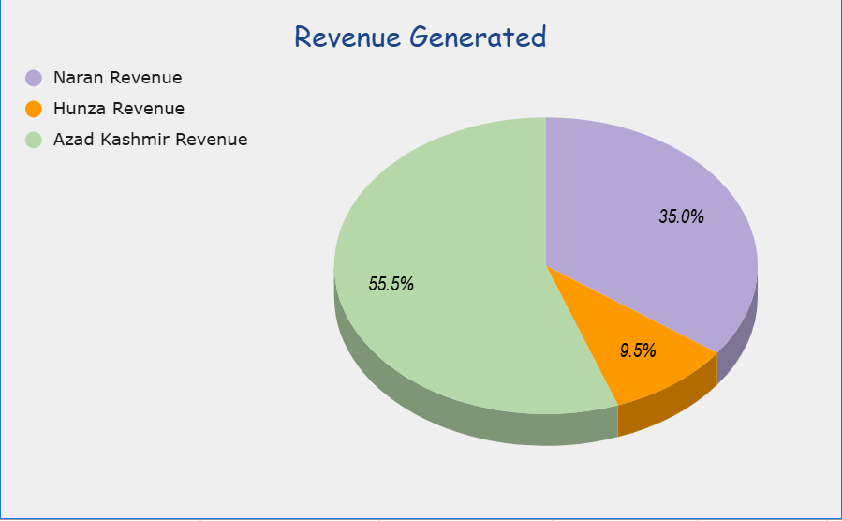

Slide 24
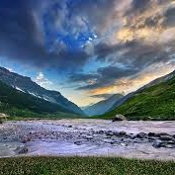
GITHUB LINK
https://github.com/noorfatima221/Dream-Travels-Website

Slide 25
REFLECTION AND NEXT STEPS

Slide 26
Reflection:
We learned how to combine web development, Excel data, and presentation skills.
The project improved our teamwork and technical understanding.
Next Steps:
Add more interactive features such as filters or booking options on the website.
Improve the design by adding animations and better responsiveness.
Expand Excel data with more destinations and performance metrics.
Collect user feedback to further enhance usability and content quality.

Slide 27
THANK YOU

